Slide 1
Hurricane Season 2017:
A Hurricane Era?
NYU LIVE Web Forum
11 May 2017
Bryan Norcross
Sr. Hurricane Specialist
The Weather Channel

Slide 2
25 Years After Hurricane Andrew
________________________
Wind: 165 mph – gusts 200+ mph
Damage (1992): $26.5 Billion
Damage (2017): $46.5 Billion
Damage (2017 Wealth): $90-100 Billion
Homeless (1992): ~350,000
Homeless (2017): 500,000 or more

Slide 3
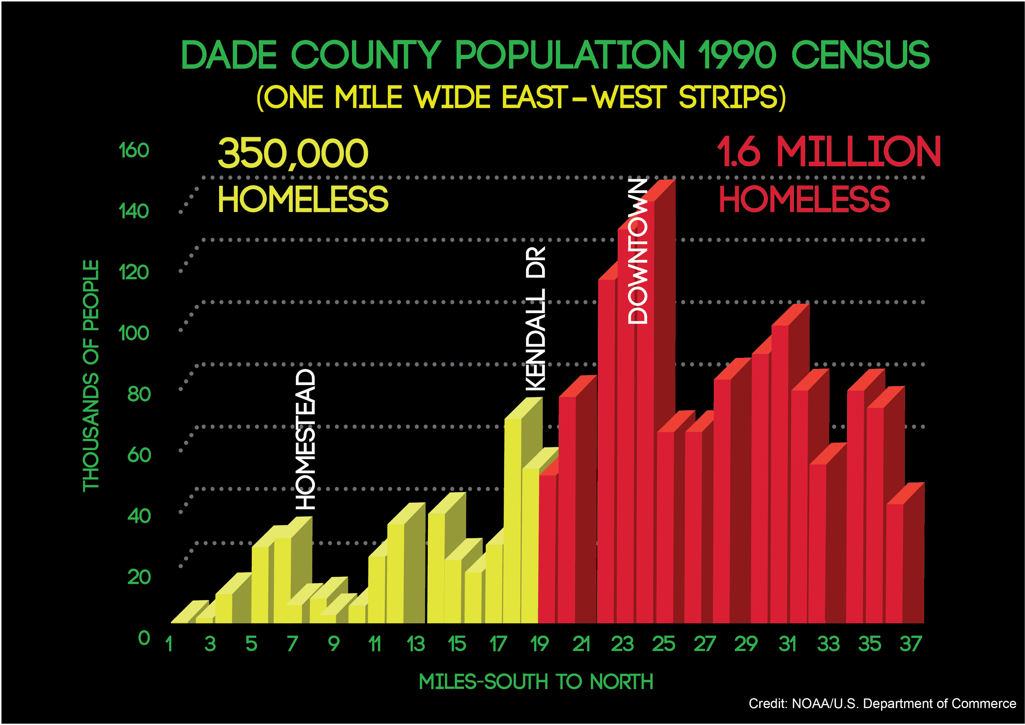

Slide 4
Busy Eras
vs.
Not-Busy Eras

Slide 5
Courtesy Phil Klotzbach

Slide 6
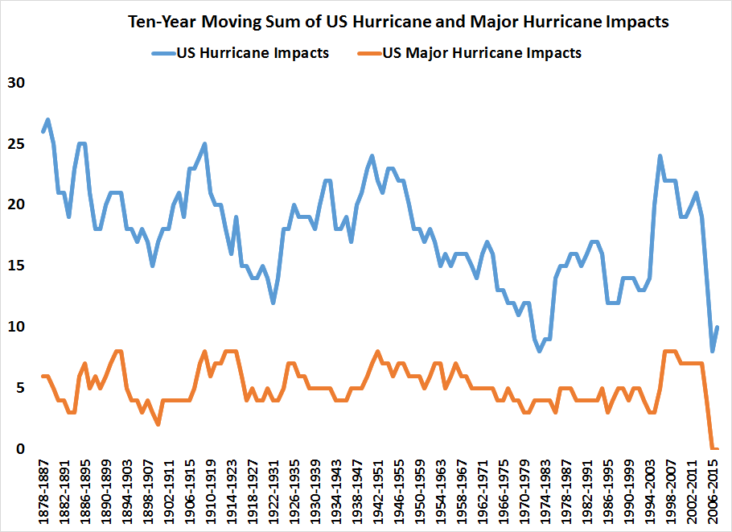
Courtesy Phil Klotzbach
The U.S. Has Been Super Lucky!
All
Landfalls
Cat 3+

Slide 7
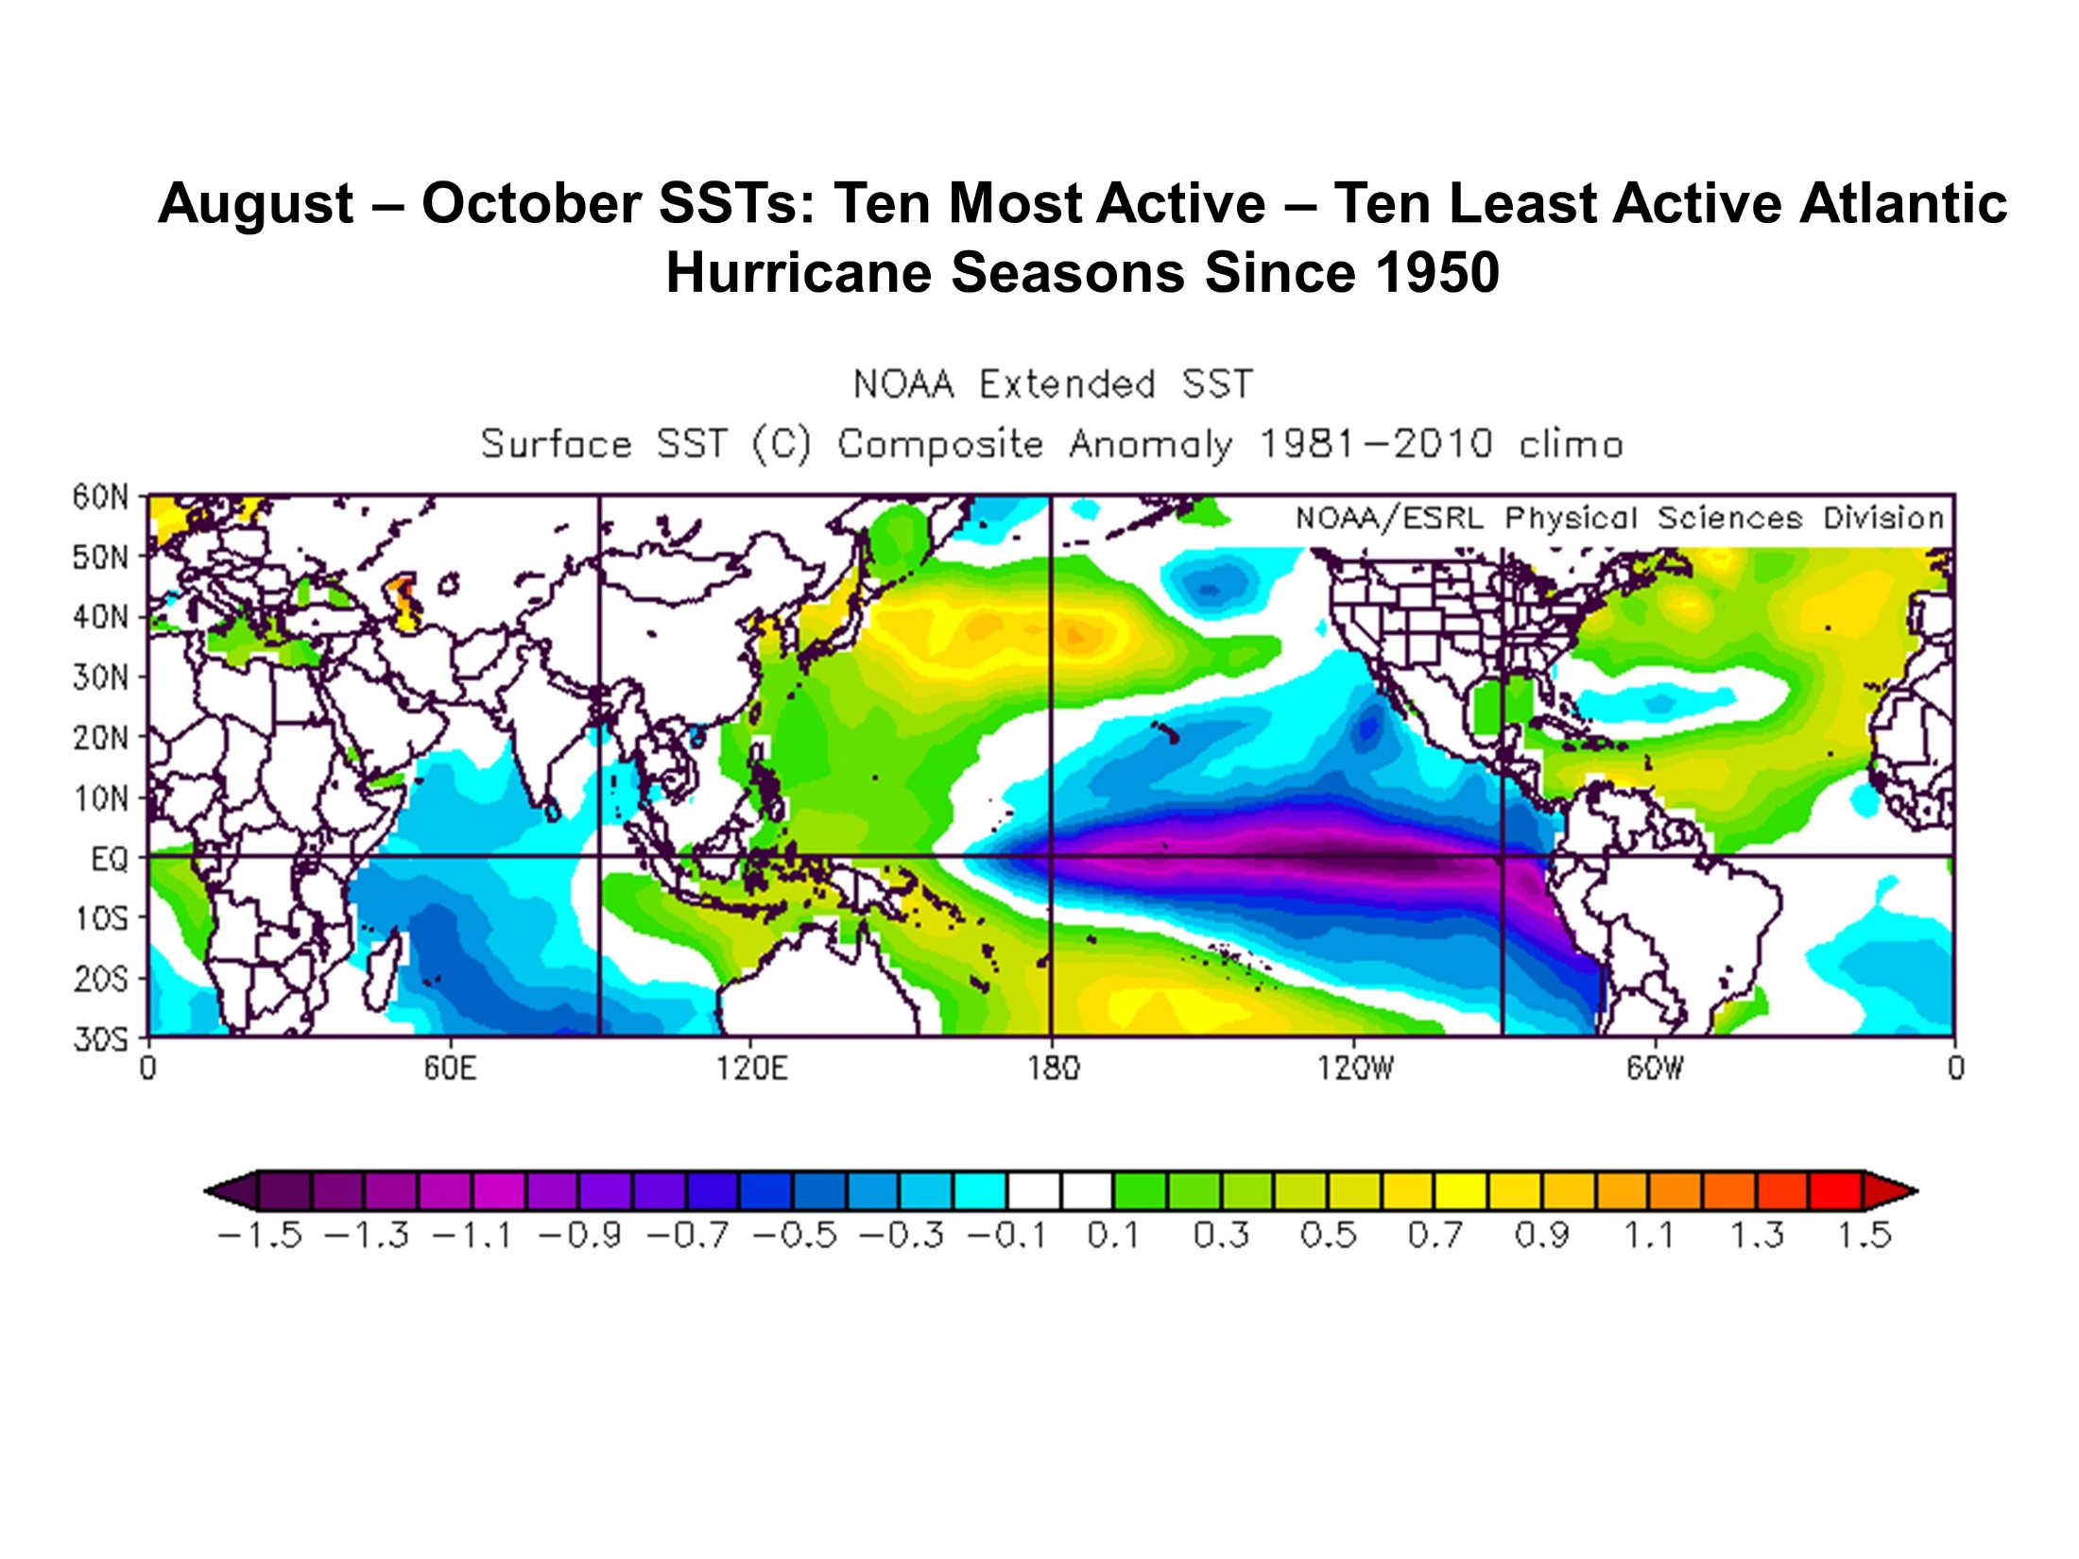
Busy Era minus Not-Busy Era
Ocean Temperature
Courtesy Phil Klotzbach

Slide 8
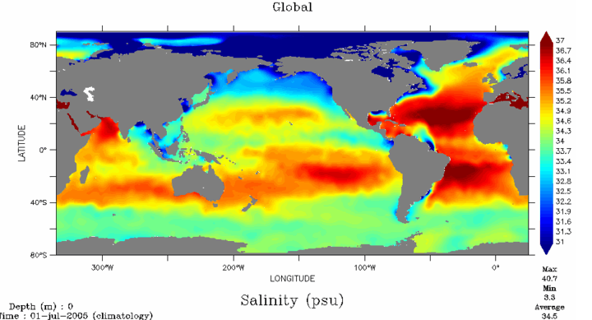
Salt Content in the Ocean
Atlantic Much Saltier
Courtesy Phil Klotzbach

Slide 9
THC (or AMO)
STRONG
Busy Era
THC (or AMO)
WEAK
Courtesy Phil Klotzbach

Slide 10
THC (or AMO)
STRONG
Busy Era
THC (or AMO)
WEAK
Not-Busy Era
Courtesy Phil Klotzbach

Slide 11
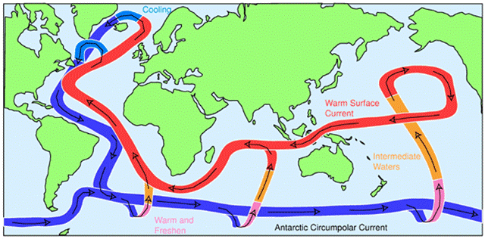
Warm Atlantic Means Cooler Elsewhere
3
1
2
Courtesy of John Marshall (MIT)
Courtesy Phil Klotzbach

Slide 12
Not-Busy Era
Busy Era
Probability of Cat 3+ impact
Courtesy Phil Klotzbach

Slide 13
Is it luck?
Or is it something?

Slide 14
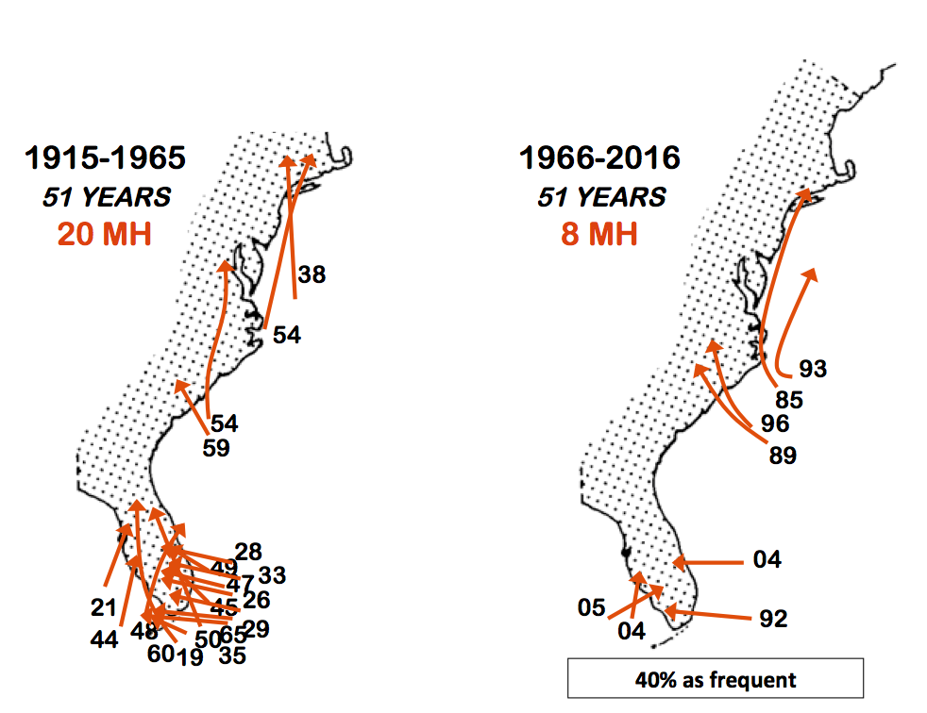
Cat 3+ Back Then
Is it luck?
Or is it something?
20 Cat 3+
8 Cat 3+
Courtesy Phil Klotzbach

Slide 15
Recent Cat 3+ Storms Turn Away
Is it luck?
Or is it something?
20 Cat 3+
8 Cat 3+
Courtesy Phil Klotzbach

Slide 16
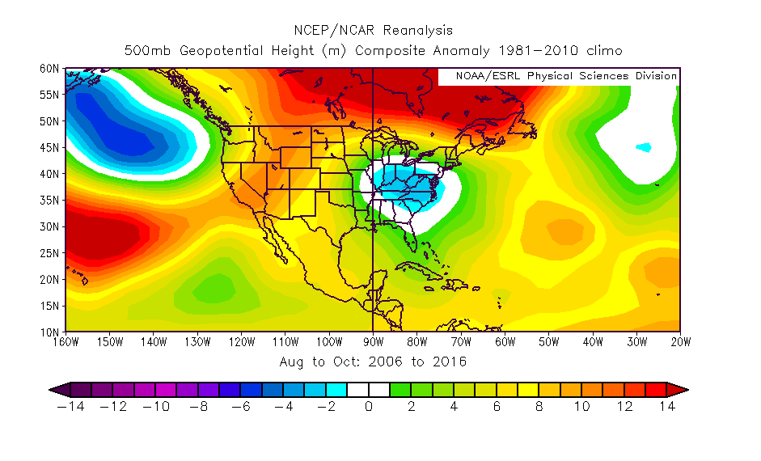
Atmospheric Pressure
Higher
Lower
Peak Hurricane Season 2006 to 2016
Courtesy Phil Klotzbach

Slide 17
2017
Hurricane Season
Forecast

Slide 18
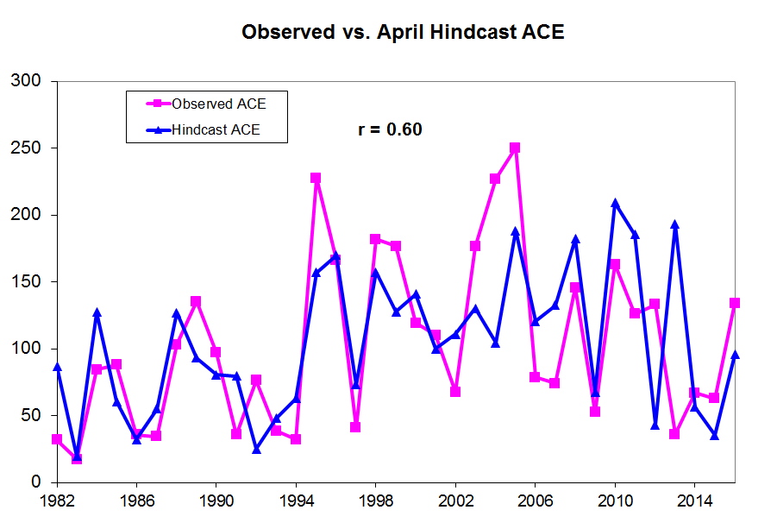
How Good Are the Forecasts?
Forecast
Actual

Slide 19
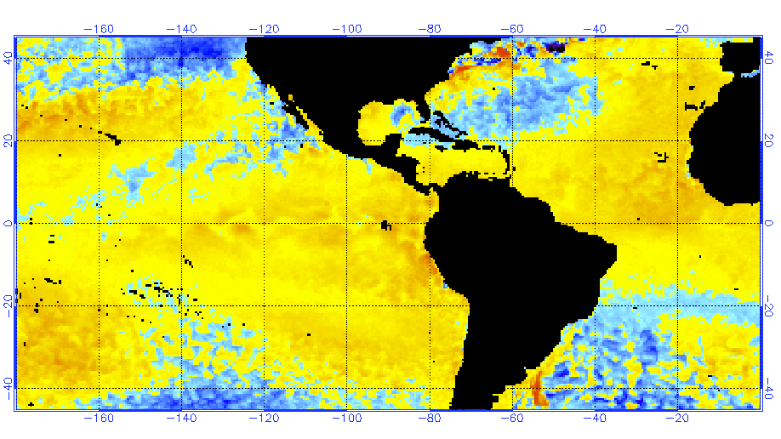
Ocean Temp Difference than Normal
April 27
Plus
Minus
Dominant Effect

Slide 20
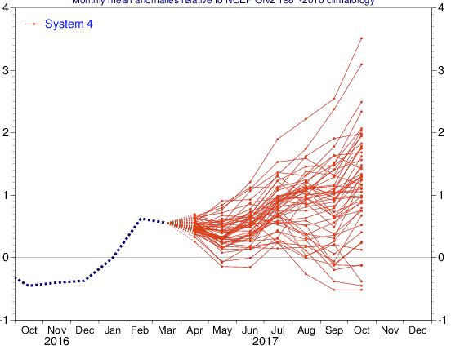
Euro Model El Niño Forecast
April 1
Moderate
Minus Effect

Slide 21
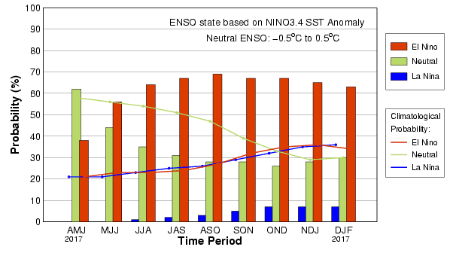
Odds of El Niño or Not
Mid April
Peak of Hurricane Season
Courtesy International Research Institute
for Climate and Society – Columbia University

Slide 22
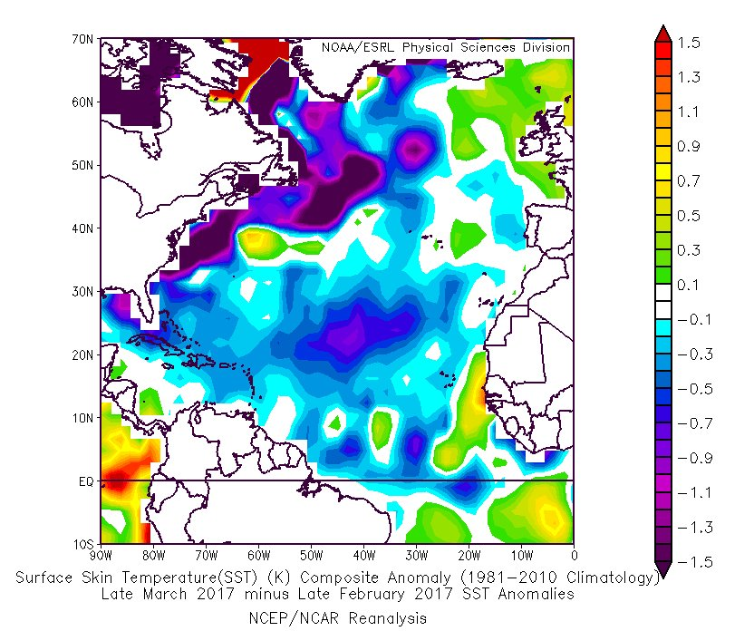
March Cooling of N. Atlantic
Slower Circulation = Less Busy Era

Slide 23
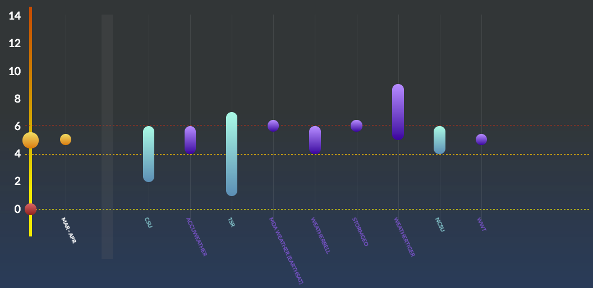
Hurricane Season Forecasts
Peak of Hurricane Season
Average #
of Hurricanes
_____________________________________
Consensus: Slightly below to near average
seasonalhurricanepredictions.org

Slide 24
Bottom Line
Average to slightly below Average
10-12 named storms
4-6 hurricanes

Slide 25
New for 2017
Hurricane Season

Slide 26
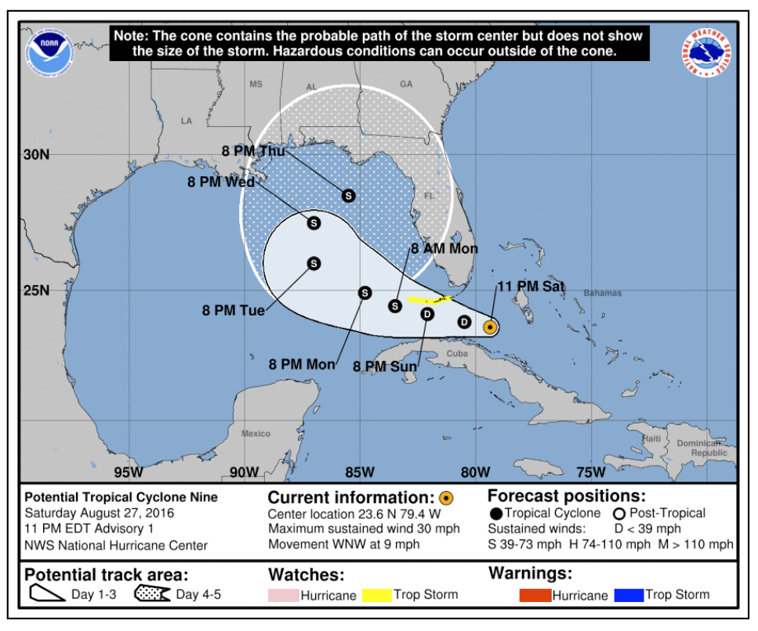
Cone & Warnings Before Development
Potential Tropical Cyclone
Moderate
Minus Effect

Slide 27
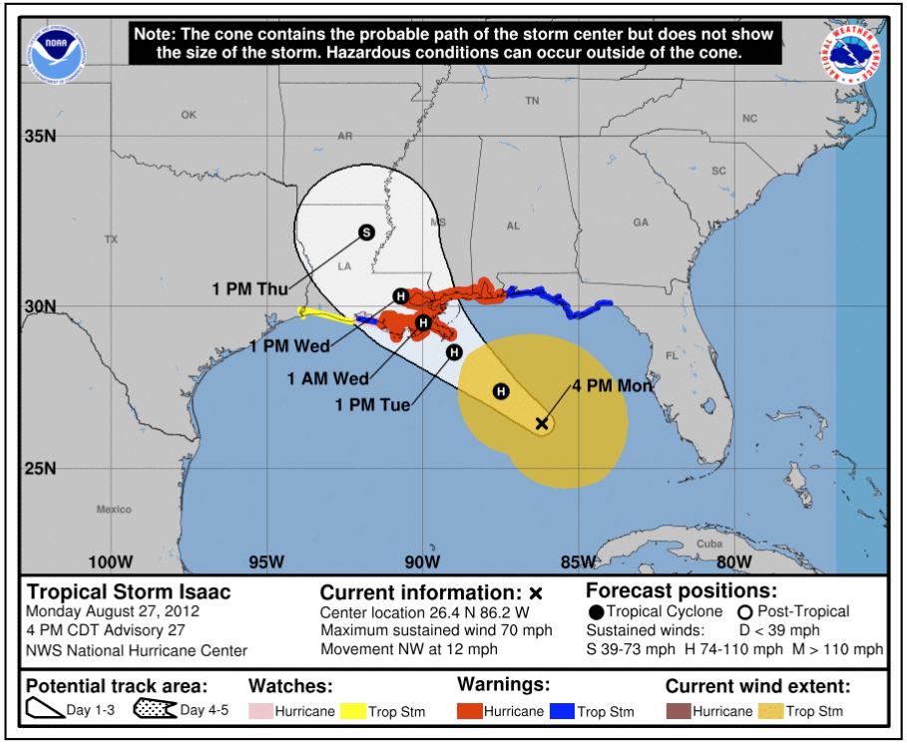
Show Storm Size with Cone
Winds of 40 mph or Higher
Moderate
Minus Effect

Slide 28
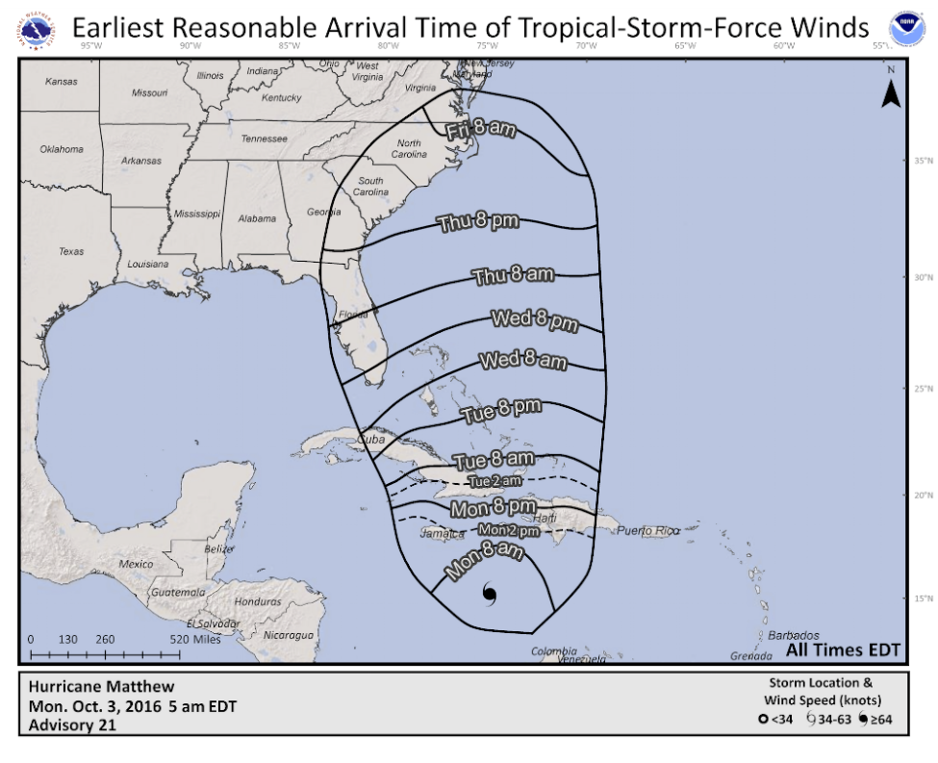
New NHC Timing Graphic
Winds of 40 mph or more
Moderate
Minus Effect

Slide 29
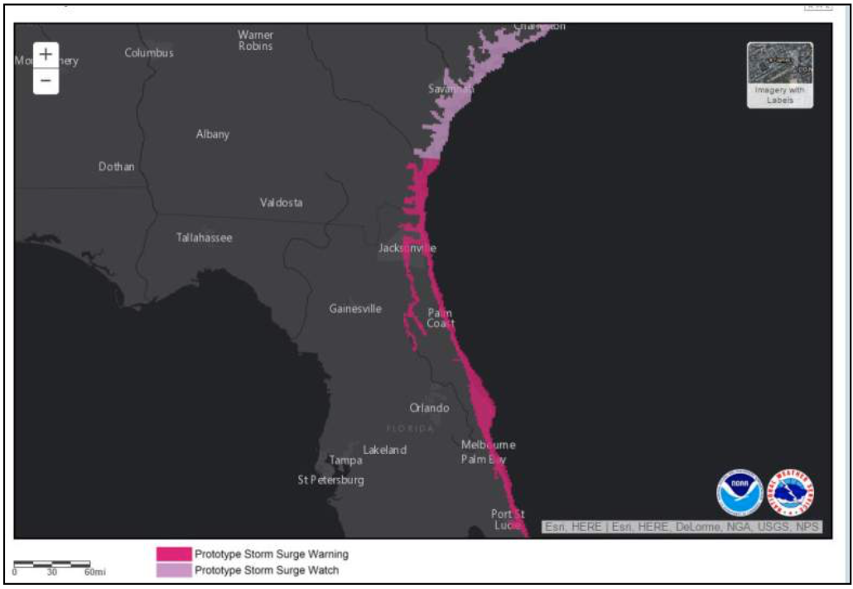
Storm Surge Watch/Warning
Separate from Hurricane Watch/Warning

Slide 30
Coming Soon to Amazon: My Hurricane Andrew Story by Bryan Norcross
Andrew coverage videos:
www.HurricaneAndrew.info
Bryan Norcross
mail@bnorcross.com
@bnorcross
facebook.com/TWCBryanNorcross

